Slide 1
The challenge to be ethical in evaluation
Dr John Donnelly | Dr Alana Hulme Chambers
Dr Alana Hulme Chambers
donnelly consultants
community development – from design to evaluation

Slide 2
What are the rights of informants and the role of evaluators in relation to the data generated by an evaluation?
What are the rights of the informants in accessing and reviewing evaluation findings?
From whom is the data collected and how is this done?

Slide 3
Presentation context
Focus on the challenges of being ethical when working with informants through the course of an evaluation
Ethics in relation to the awareness of, and subsequent respect and protection of, evaluation informants’ rights (Schwandt, 2007)
International development and domestic examples
Notes:
This paper focuses on the challenges that the notion of being ethical presents when working with informants during the course of an evaluation. Whilst ethics in evaluation can include the conduct of the evaluator in relation to evaluation, and/or the moral-political orientation of the practice of evaluation (Schwandt, 2007a:118), this paper is focused on ethics in relation to the awareness of, and subsequent respect and protection of, evaluation informants’ rights. The aim of the paper is to explore the rights of informants and the role of evaluators in relation to the data generated by an evaluation; from whom is the data collected and how is this done, and the rights of the informants in accessing and reviewing the evaluation findings.

Slide 4
Ethical guidelines
AES ‘Guidelines for the Ethical Conduct of Evaluation’
22 guidelines
Broad, with room for interpretation
What to do when guidelines don’t provide suitable references of ethical issues that have arisen?

Slide 5
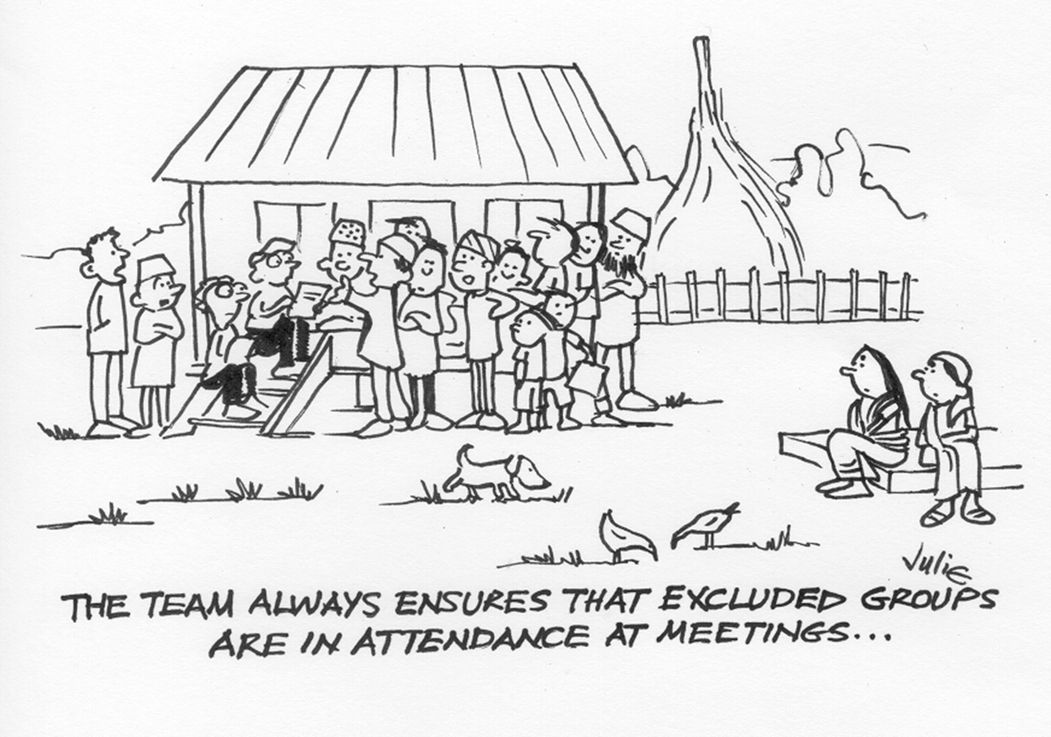
Scenario 1: from whom is data collected and how is this done?

Slide 6
Overcoming ethical dilemmas around data collection…
Tools should be culturally appropriate and user friendly
Self selection by participants evens the power differential and sense of control
Various ‘opt out’ mechanisms
Recognising vulnerability
Flexibility in methodology
Time for building trust and respect
Doing your homework before conducting interviews

Slide 7
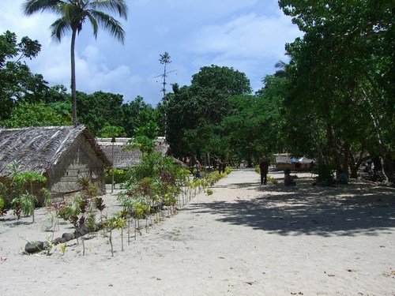
Scenario 2: rights of informants in accessing & reviewing findings

Slide 8
Overcoming ethical dilemmas around informants rights re findings
Provide opportunities for informants to be involved in design of data collection phase and data analysis phase
Train informants to undertake sections of the evaluation
Informants gain skills, confidence or information from involvement

Slide 9
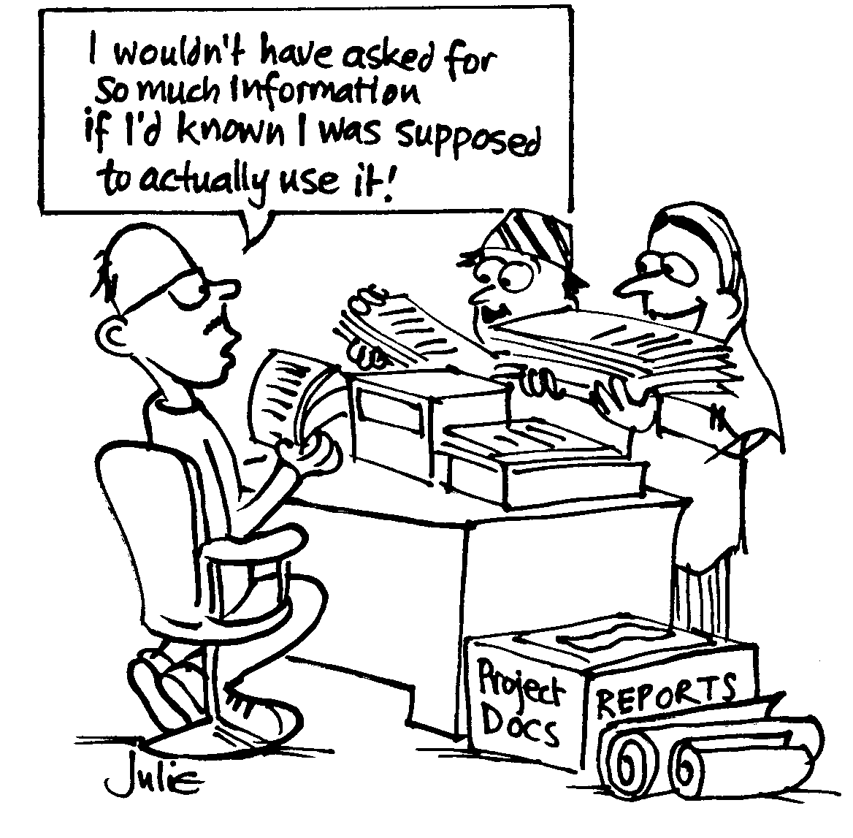
Data collection: what’s in & what’s out
Notes:
Insert a picture that illustrates some part of your country’s economy.

Slide 10
Overcoming ethical dilemmas around use of data form informants
Be clear from the outset as to what will likely occur with the data
Offer the opportunity for informants to review the data and withdraw it if they choose
Consent to participate is an ongoing negotiation rather than a one-off discussion
Notes:
Insert a picture of one of the points of interest for your country.

Slide 11
In conclusion
Not just about reflecting on guidelines, but also on the culture in undertaking evaluations in particular circumstances, such as time or other constraints
There is an opportunity for the evaluation community to further discuss the challenge to be ethical in evaluation, particularly in relation to informants’ rights

Slide 12
Thank you
Feedback?
Questions?
Further considerations?
jsdonnelly@bigpond.com
achambers@gatewaycommunityhealth.org.au

